Slide 1


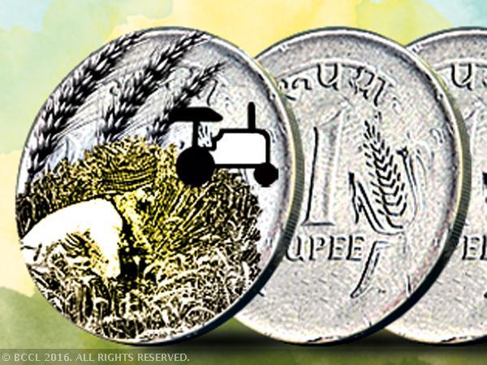
CROP INSURANCE
CLAIM PLATFORM
Team 2 : Benevolent Dictators
Tejaswi Boggarapu( IIM Kozhikode)
Hitendra Badgujar (Msc PHM ,Dapoli)
Tushar Patil (ABM , Pune)
Mama Mohanty(OUAT,BBSR)
Mona Kumari(OUAT,BBSR)

Slide 2
EXISTING SYSTEM
PRADHANMANTRI KRISHI BIMA YOJNA
YIELD BASED INSURANCE
FARMER TAKES INSURANCE
WEATHER BASED INSURANCE
DAMAGE/LOSS OF YIELD
CLAIMS RECEIVED BY FARMAERS
CLAIM
PVT SECTOR INSURANCE AGENCIES
DISBURSEMENT TO BANKS
DATA
INVESTIGATION
APPROVAL
SUBSIDIES FROM GOVT. APPROVAL

Slide 3
PROPOSED SYSTEM
IMD
Satellite imaging system
Gov. Crop Insurance
Insurance claim platform
Approved
Insurance Disbursed to Farmers
Private insurance company

Slide 4
EXISTING SIMILAR SOLUTIONS ?
Insurance earlier was region based(entire area gets affected by drought, compensation by govt.)
Actual crop insurance & weather based protection (implemented under PMFBY a year ago).
No concept of crop insurance for farmers earlier- Penetration Low
No formalized process for claims-handled through informal means, human intervention needed.
Gestation period(avg) of 3-5 months.
Solution proposed-NOVEL
First Mover Advantage

Slide 5
IMPACT
REVOLUTIONISE HOW CLAIMS ARE PROCESSED
FARMER
1. REDUCTION OF CLAIM TIME -TO 1-2 WEEKS.
2. HASSELE FREE PROCESS 3.NO HUMAN INTERVENTION
GOVERNMENT
INCREASED PENETRATION OF CROP INSURANCE UNDER PMFBY.
DATA
REAL TIME DATA
1. FARM INPUT INDUSTRIES
2. FMCG COMPANIES(Retail)
DATABASE
1. FOOD PROCESSING INDUSTRIES
2. INSURANCE COMPANIES
3. BANKS
4. CAPACITY PLANNING(Godowns)
5. AGRICULTURE DEPARTMENT

Slide 6

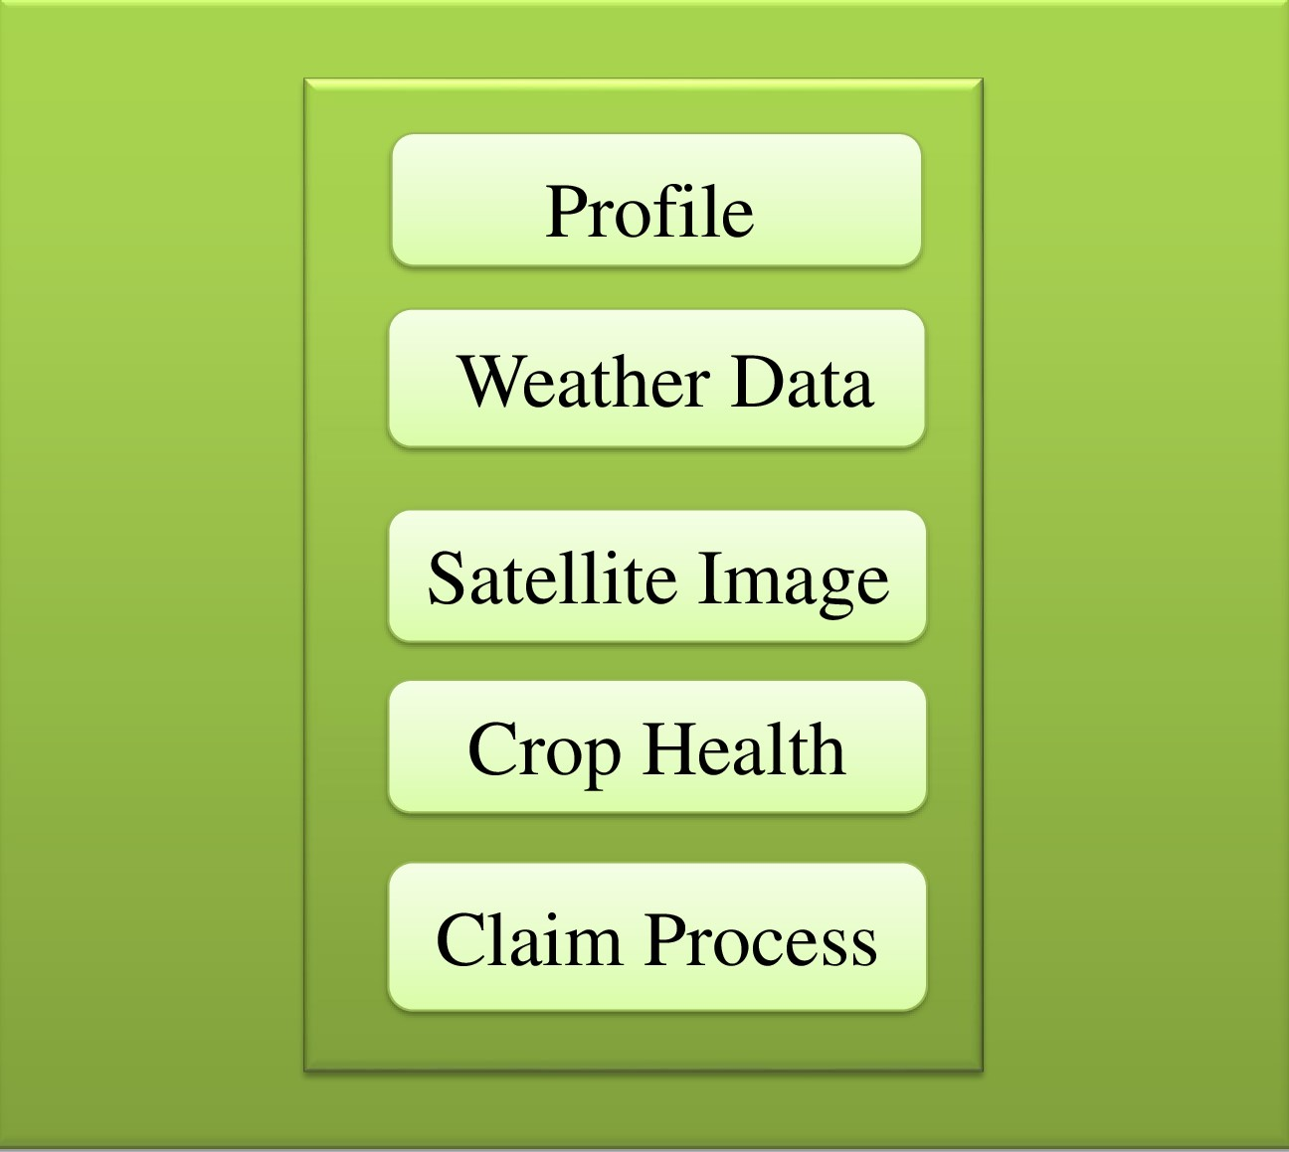
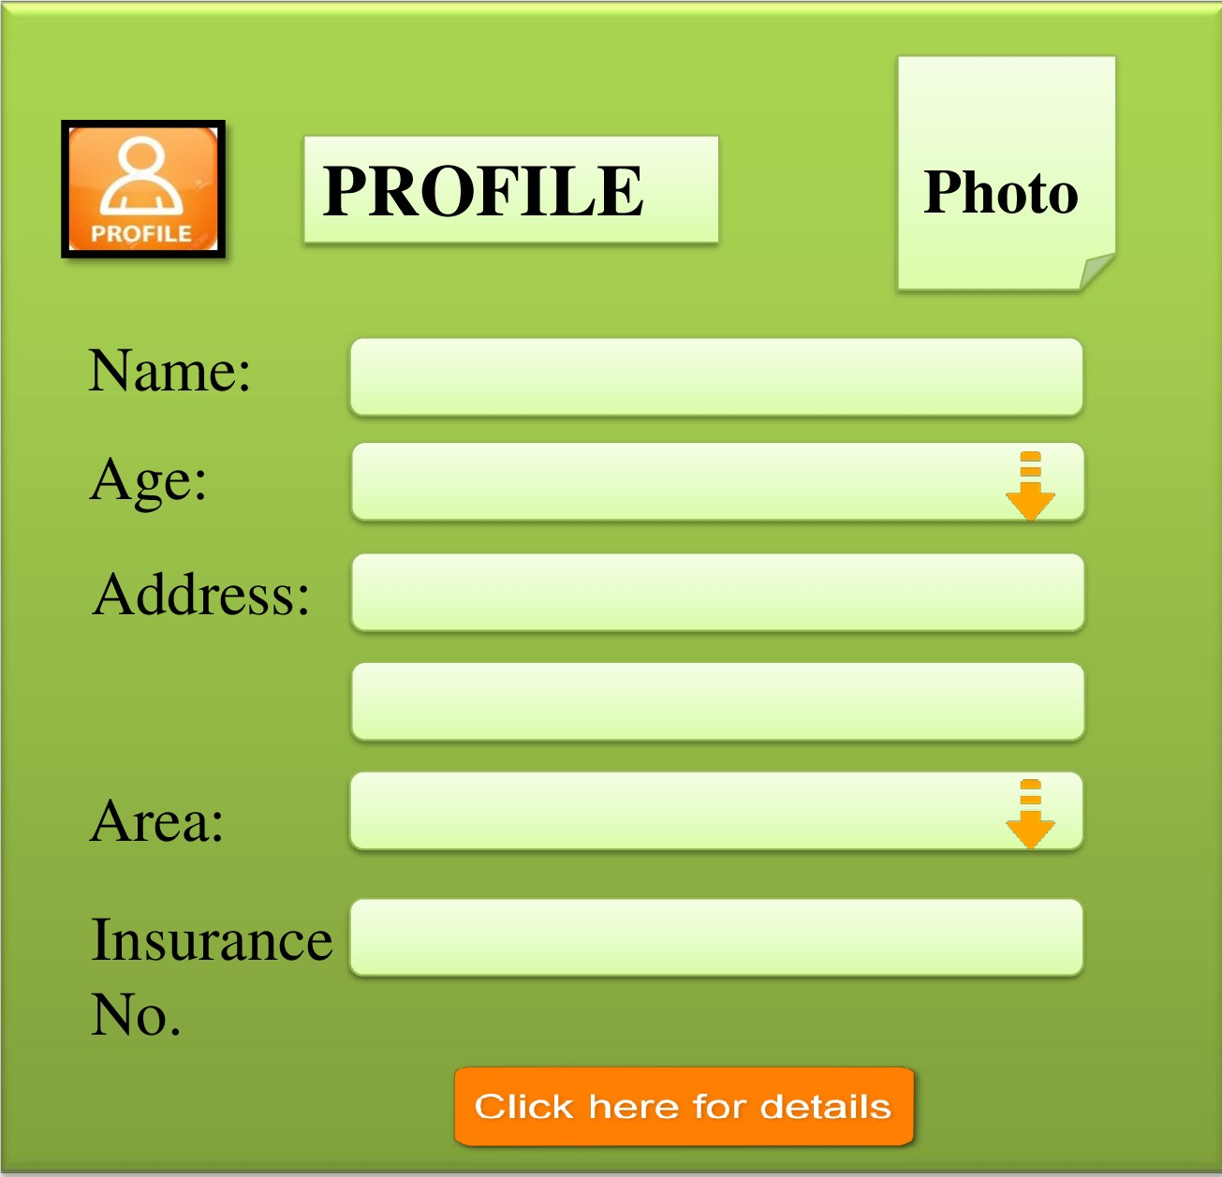
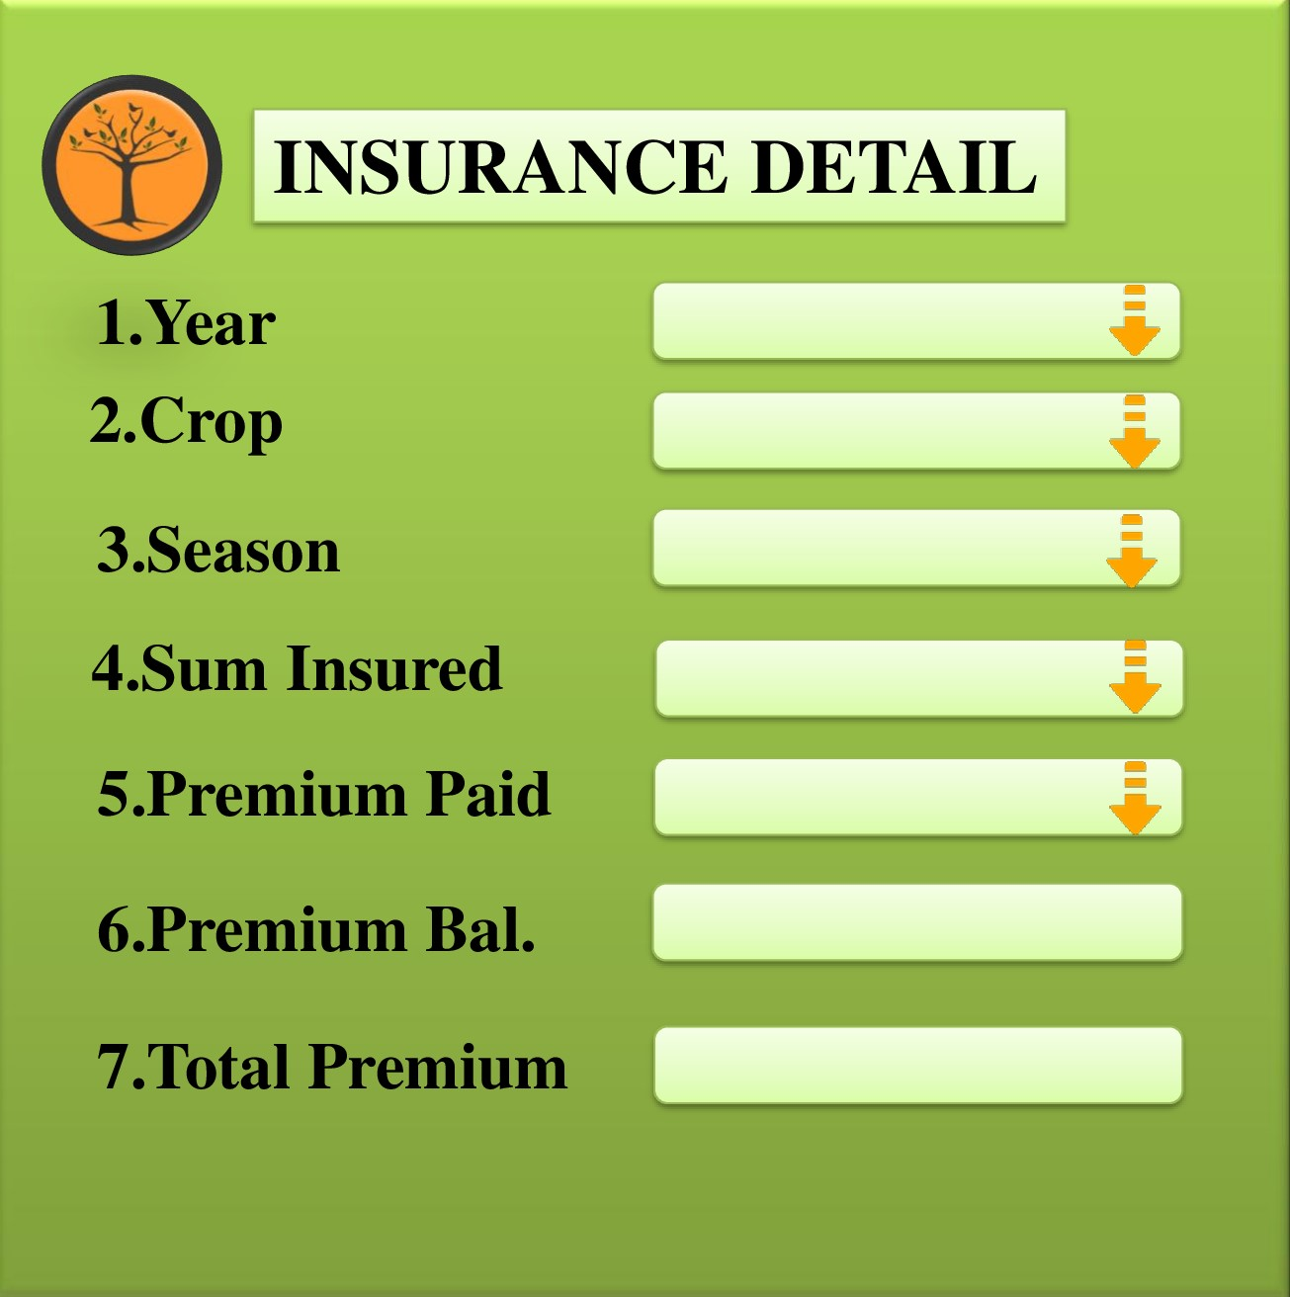
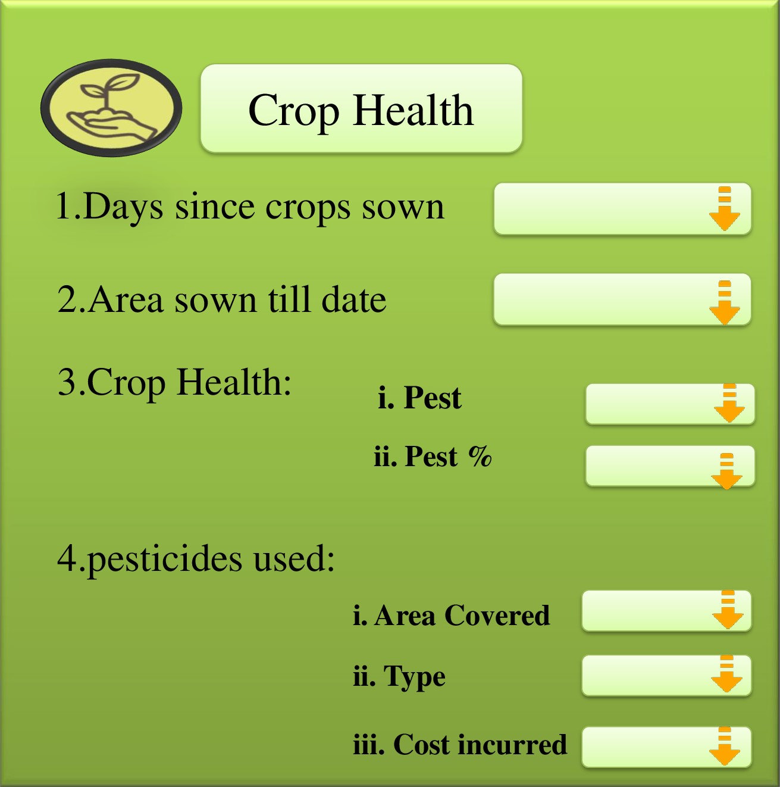
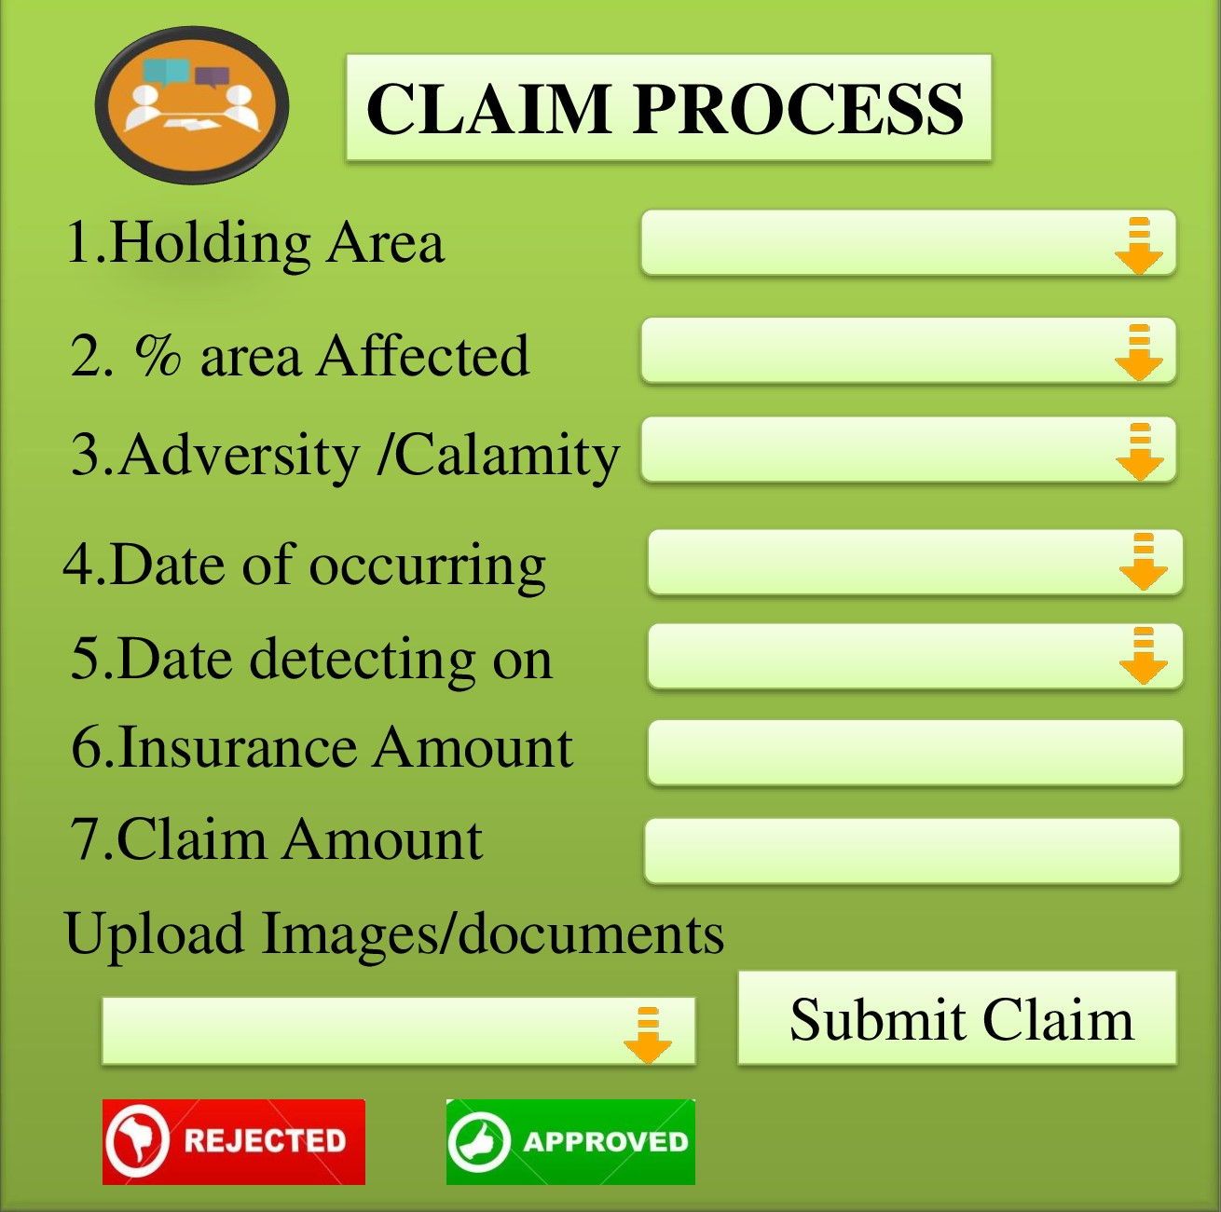

Slide 7
BUSINESS MODEL
.
Benefector
Farmer
Farming community
Revenue source
Insurance Providers
Agri input based industry(Long Term)
Data(Long Term)
Strategy
Economies of scale and Cooptation
Satellite imaging systems(Planet Labs, Skybox, Urthe Cast e.t.c)
IMD
Government(Farmer data to be waived off Later)
Future
Insurance Aggregator
Data Provider
Complete facilitation of PMFBY

Slide 8
REVENUE MODEL
Total CAPEX | 1360000
 | Revenue Generated (1) & (2) Rev1(2% premium) Rev2(6% Payout)
 | No | Ins Amount | Premium | Payout | Rev1 | Rev2
1 | 100 Farmers | 5000000 | 116000 | 376800 | 2320 | 22608
2 | 25 Farmers | 2500000 | 109750 | 170400 | 2195 | 10224
 |  | Revenue Total |  | 37347
 | Cost Estimates
 | Satellite Imaging | 18500
 | IMD(Per season) | 8000
 | Farmer Data | 1250
 | Google data(past) | 0
 | Profit | 9597
Crop Failure/Yield (1)
Premium | 1.5% to 3.5 %
Weighted average Premium | 2.32%
Weather Based (2)
Premium | 2% to 6%
Weighted average Premium | 4.39%
Other Major Operating Expenses(Yearly)
IT Maintenance |  | 100000
Wages and salaries |  | 300000
Miscelanneous Expenses |  | 200000
Total |  | 600000
Break Even | 4.68 Yrs

Slide 9
IS IT VIABLE?
USAGE OF CLOUD
AVAILABLE IN VARIOUS LANGUAGES
SCALABLE
REASON
Over period of time
MACHINE LEARNING TECHNIQUES
ADAPTABILITY
INTEGRATION
RESTFUL WEB SERVICES
DURABILITY
EASY TO USE
WEB BASED/APP BASED
PLATFORM(1.5 months)
IMPLEMENTATION
NEGOTIATIONS(3-6 months)

Slide 10
MARKETING STRATEGY
BRINGING ON BOARD
.
GOVT
1.Successful implementation of policy
2.Penetration of insurance
3.Integration of depts.
.
.
INSURANCE PROVIDERS
1. Growth in number
2.Revenue growth potential
NEW POTENTIAL PARTNERSHIPS
DATA PROVIDER
1.Govt.
2.FMCG & Food Processing Industries
3.Insurance Companies, Banks
4.Capacity Planning(godowns)
INSURANCE COMPANIES
Insurance aggregator
platform

Slide 11
THANK YOU

